Slide 1
New challenges in electricity markets
Reinhard HAAS
Energy Economics Group, TU Wien
Summerschool, June 2017

Slide 2
CONTENT:
1. Introduction: Recent developments
2. How prices come about in electricity
markets
3. Impact of variable renewables on prices
4. Supply security and dimensions of
electricity markets
5. The role of storages
6. Conclusions

Slide 3
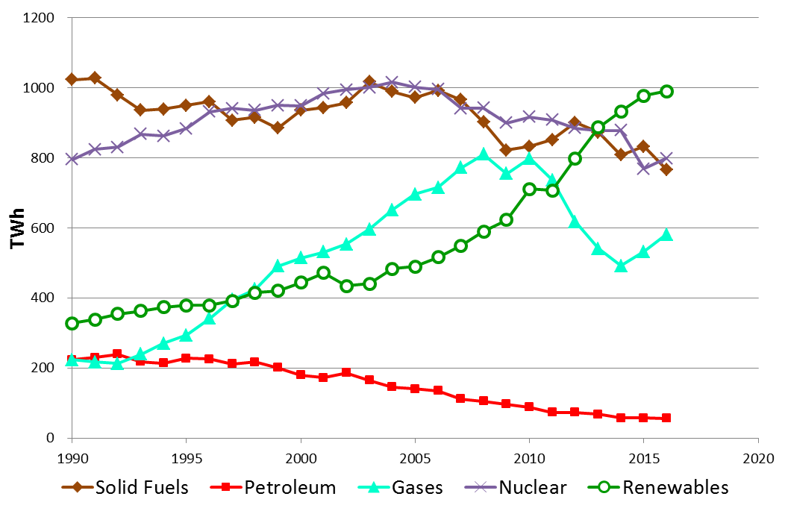
1. Introduction:
Electricity generation EU-28

Slide 4
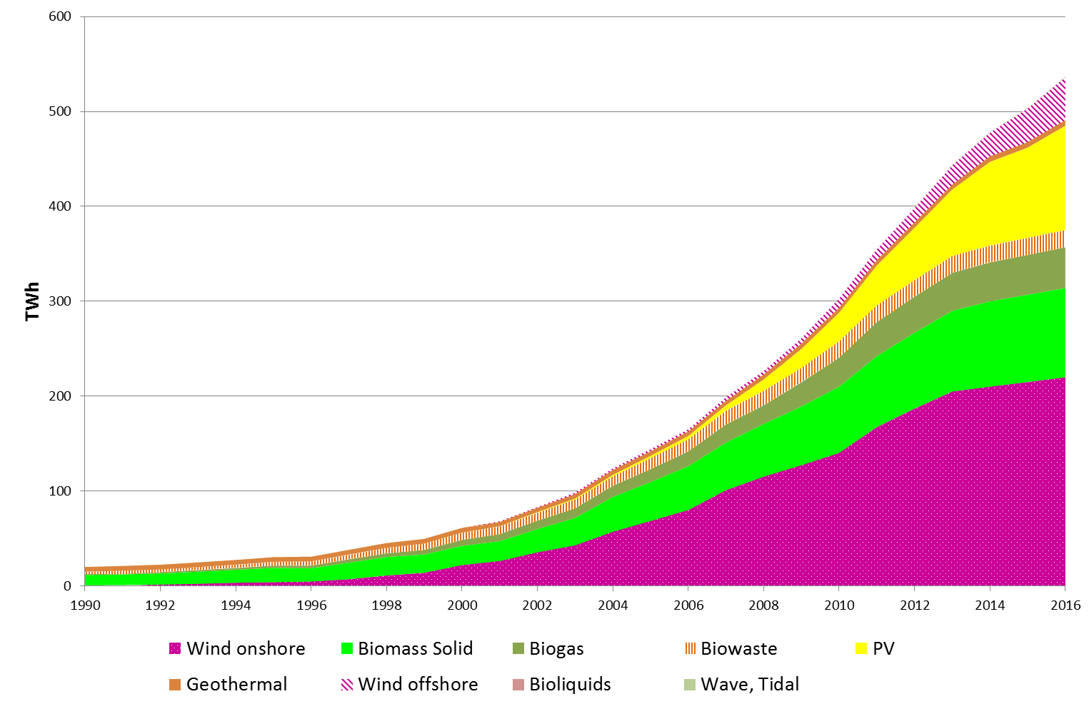
EU-28: Electricity generation
from „new“ RES
2016: 16 %
(preliminary)
1997: 1 %
Source: EUROSTAT, own estimations

Slide 5
2. HOW PRICES COME
ABOUT (SOME THEORY)
before liberalisation
after liberalisation
Strategic prices
Average
costs
Price, costs (EUR/MWh)
Long-term
marginal costs
Short-term
marginal costs
time

Slide 6
The MERIT-ORDER
curve of supply
based on short-term marginal costs (MC)
Coal (old)
Supply curve S:
marginal costs
Natural gas (new)
Costs (EUR/MWh)
Coal (new)
Nuclear
Hydro, Wind
MWh

Slide 7
BASIC PRINCIPLE OF COMPETITION:
PRICE = MARGINAL COSTS
p_{t2}
Demand
D_{t1}
e.g. Natural
gas new
Demand
D_{t2}
Costs,Price (EUR/MWh)
Price = „System“-marginal costs
e.g. Coal
new
p_{t1}
Supply
curve
Nuclear
Hydro, wind
MWh

Slide 8
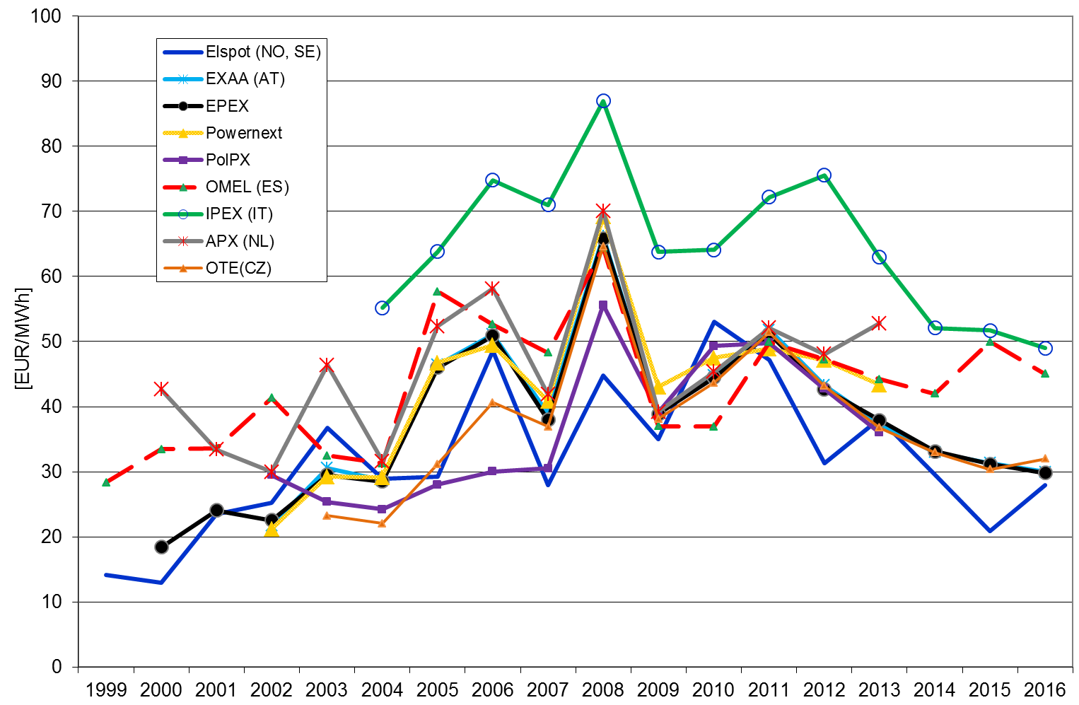
Development of day-ahead
electricity prices in Europe per year
AT, DE, FR, CZ, PL
→ One market!

Slide 9
WHY?
STMC = 0!

Slide 10
PV AFFECTS THE ELECTRICITY MARKET PRICE IN GERMANY
On-peak time: Low
electricity prices!
Photovoltaics
Spot market price electricity Germany
Structure of electricity generation over a day

Slide 11
LONG-TERM
VS
SHORT-TERM
MARGINAL COSTS

Slide 12
What are marginal costs (MC)?
MC= C‘(X) = dC(x)/dX
Marginal costs are the increment of costs due to a generation of one additional unit of kWh
P=MC
Short-term marginal costs (STMC):
STMC= Fuel costs + CO2 costs
Long-term marginal costs (LTMC):
LTMC= STMC + Capital costs + O&M costs

Slide 13
LONG-TERM MARGINAL
COSTS
1.
2.
3.
Cheapest:
Nuclear
Coal
Wind
Costs (EUR/MWh)
Capital costs
Operation/Fuel costs
CO2 costs

Slide 14
SHORT-TERM MARGINAL
COSTS
3.
2.
1.
Cheapest:
Coal
Costs (EUR/MWh)
Nuclear
Wind
Operation/Fuel costs
CO2 costs

Slide 15
Expectation of:
prices = Short-term marginal costs:
(Short-term marginal costs = fuel costs)
due to huge depreciated excess capacities at the beginning of liberalisation!

Slide 16
3 HOW VARIABLE RENEWABLES IMPACT
PRICES IN ELECTRICITY
MARKETS

Slide 17
PRICES WITHOUT AND
WITH PV
Demand D_{t}
Costs,Price (EUR/MWh)
Price = System marginal costs
Supply
curve
w/ PV
Price with PV!
Supply
curve w/o PV
PV
MW

Slide 18
CATEGORIES OF „PROBLEMS“:
1. Prices decrease to Zero (or below) at a number of days;
2. Lacking contribution margin to fixed costs
3. On how many days will we face high and on how many dayslow prices?

Slide 19
PRICE SETTING UNDER
EXCESS CAPACITY
Demand
coal
(new)
Marginal
costs
Costs,Price (EUR/MWh)
Hydro, Wind, PV
RES_{max}
MWh
Negative price = excess price
X
MWh

Slide 20
PROBLEM: EINFLUSS TEMPORÄR GROSSER MENGEN EET (?) AUF SPOTMARKTPREISE
Negative Marktpreise am 16.6.2013

Slide 21
Spotmarktpreisveränderung durch
Abregelung von Windkraftanlagen

Slide 22
  Prices under scarce
  capacities
Strategic
bidding
Price = strategic bid
LTMC
Costs,Price (EUR/MWh)
Price = long-term marginal costs
STMC
e.g. Natural
gas new
Price = short-term marginal costs
Supply
curve
Run-of-river hydro,
wind
Nuclear
D_{t1}
D_{t2}
MW

Slide 23
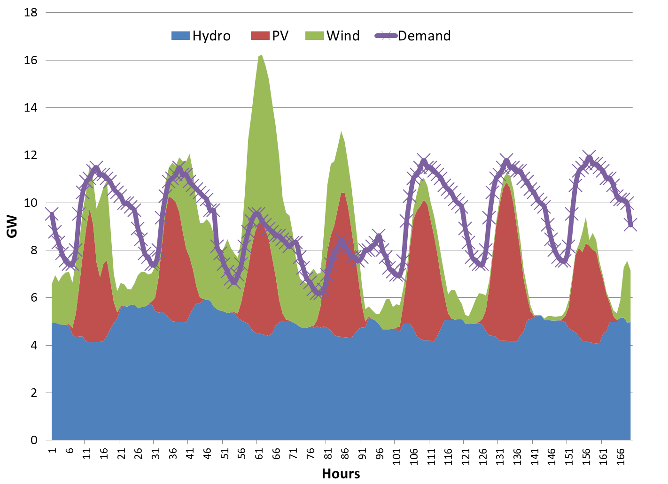
  Example: Supply and
  Demand
RES Production
> Demand
RES Production
< Demand
Demand

Slide 24
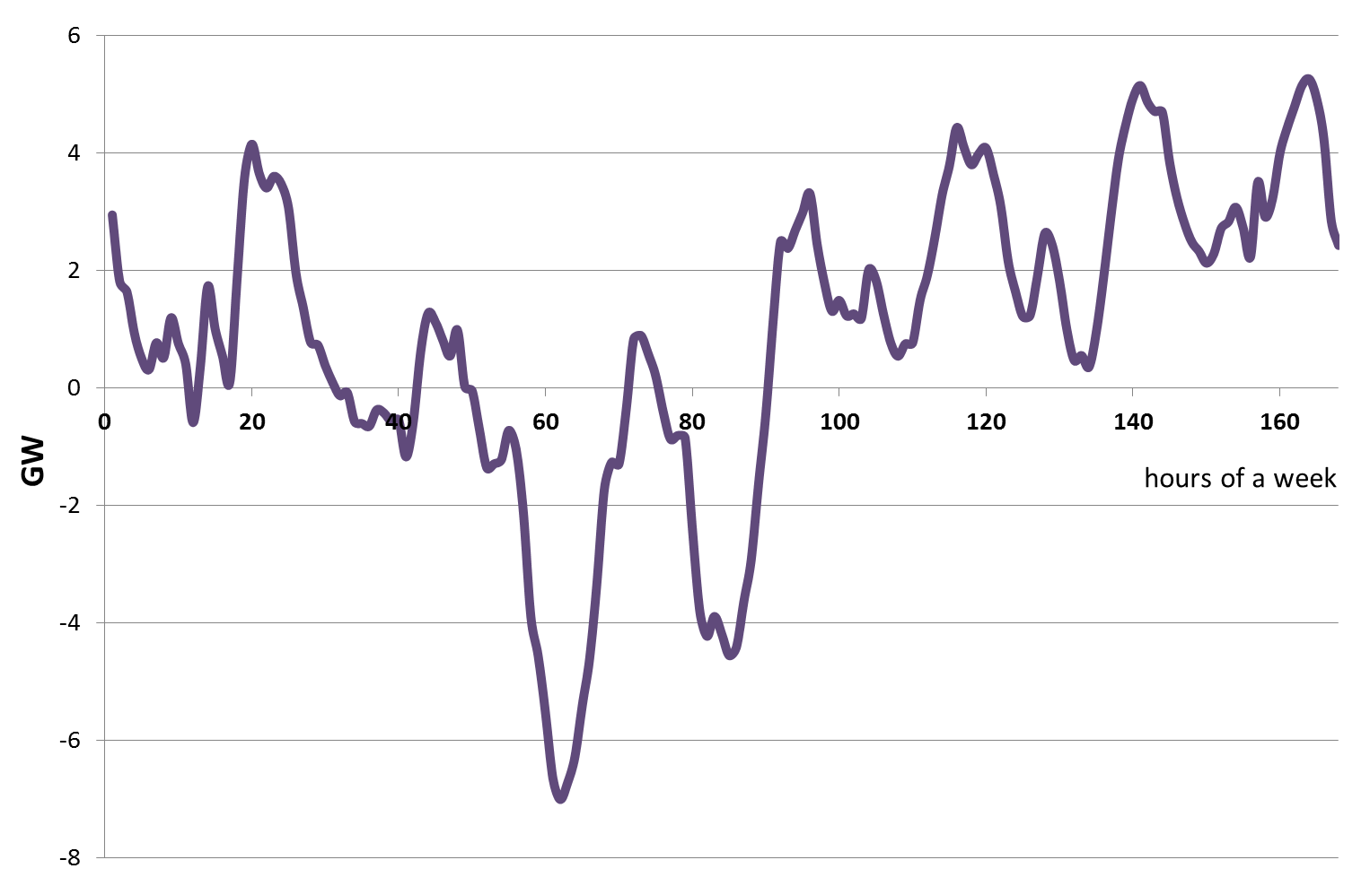
  Key term of the future:
  Residual load
  (base load is “dead”)
Under coverage
Excess electricity
  Residual load = Load – non-flexible generation

Slide 25
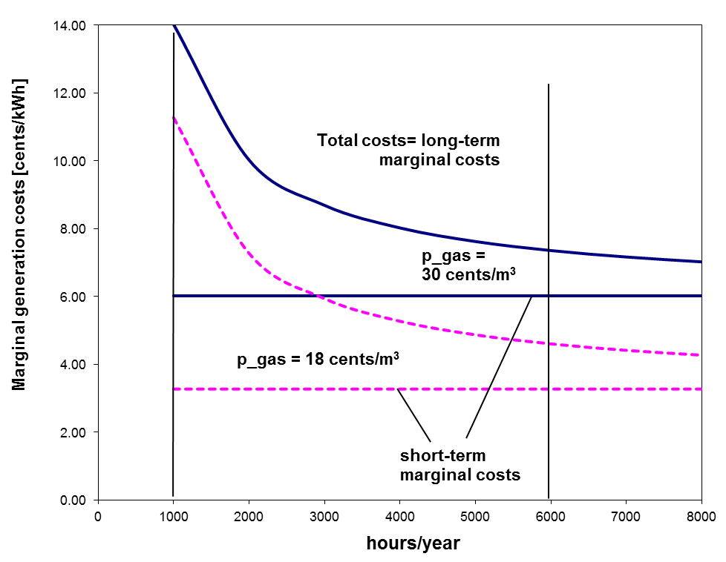
  Auswirkungen auf GUD-Kraftwerke
Fixe Kosten
je kWh
Fix costs per kWh
1000
6000

Slide 26
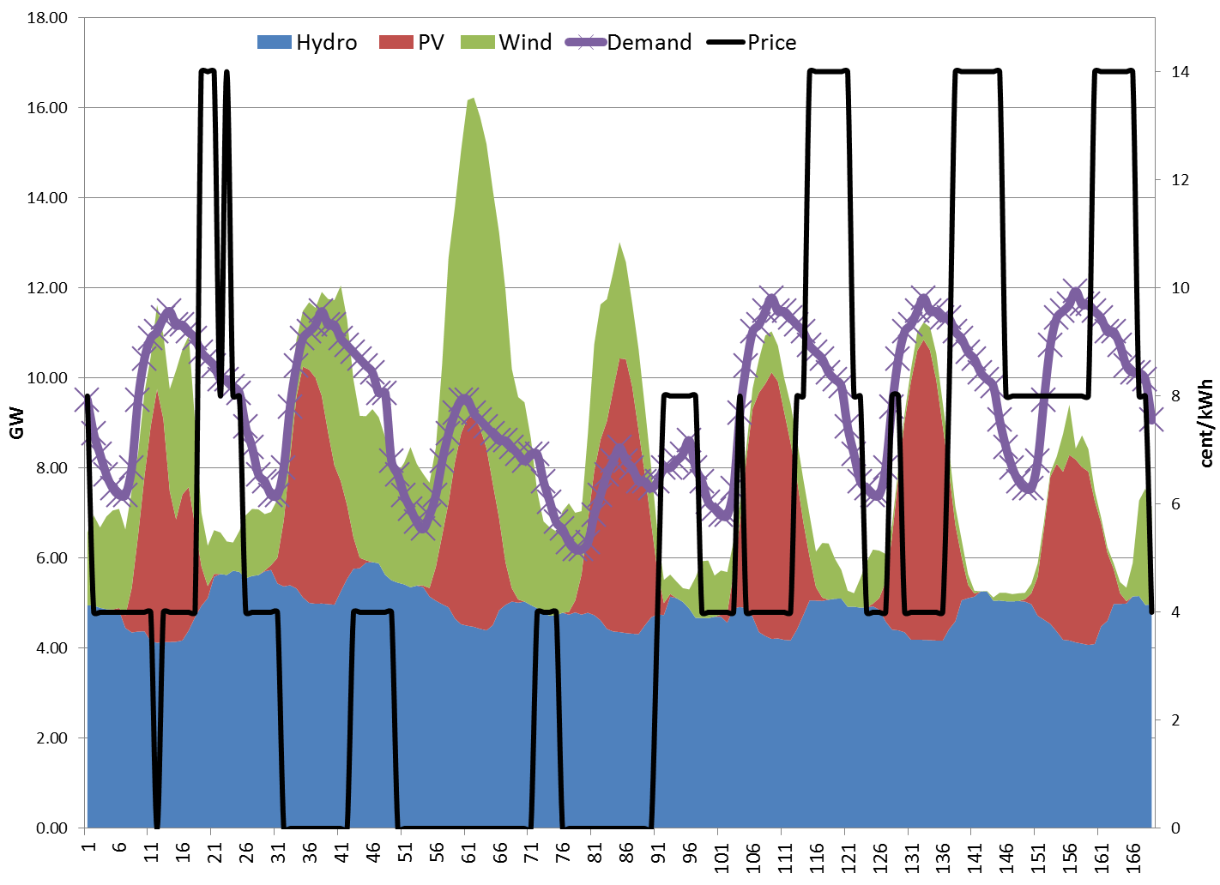
  Temporarily high prices
Electricity price
= high !
Electricity price = 0
(or negative)

Slide 27
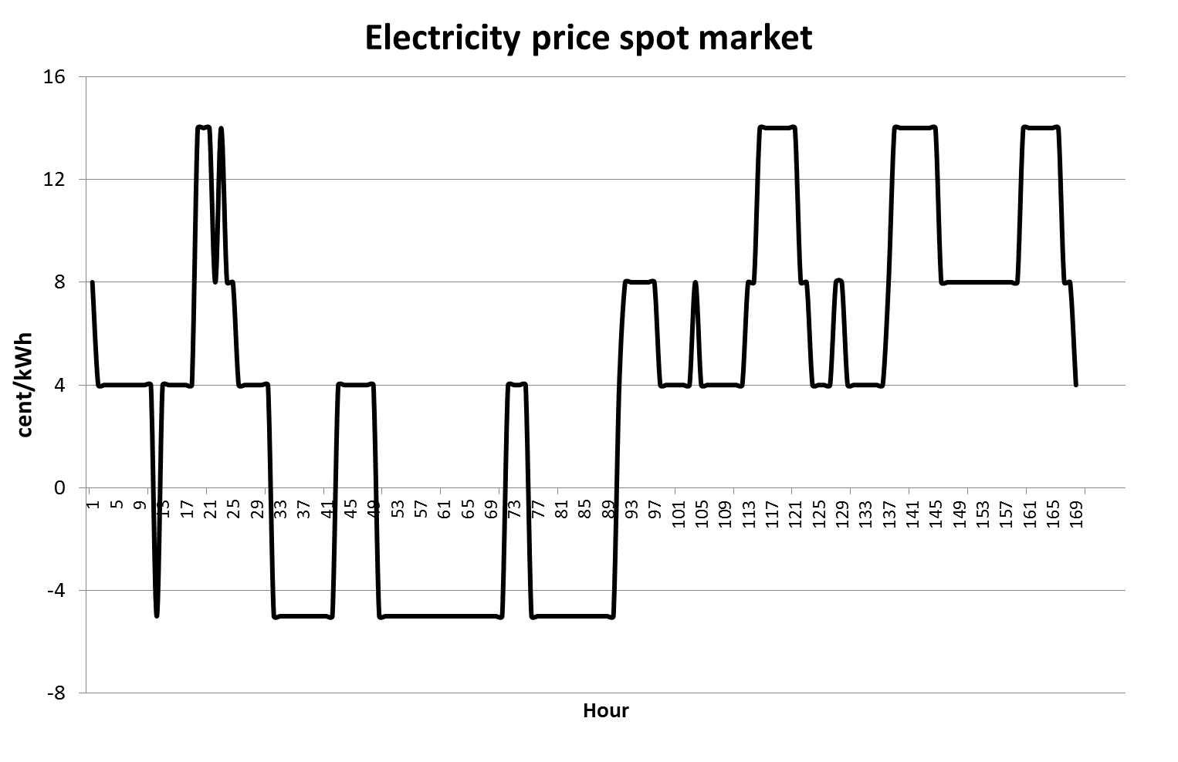
Are these prices TOO HIGH?
p_{t1}
New price spreads
Negative prices!
p_{t2}
→ These price spreads provide incentives
for new flexible solutions!!!!

Slide 28
Given this price pattern it would be
attractive for (some) power plant operators
to stay in the market
→
REVISED ENERGY-ONLY MARKET

Slide 29
DIMENSIONS OF ELECTRICITY MARKETS
SUPPLY
DEMAND-SIDE
MANAGEMENT
(TECHNICAL)
STORAGES
GRID EXTENTION
DEMAND
RESPONSE
(PRICE SIGNALS)
SMART GRIDS

Slide 30
6. NEED FOR NEW MARKET MODELS

Slide 31
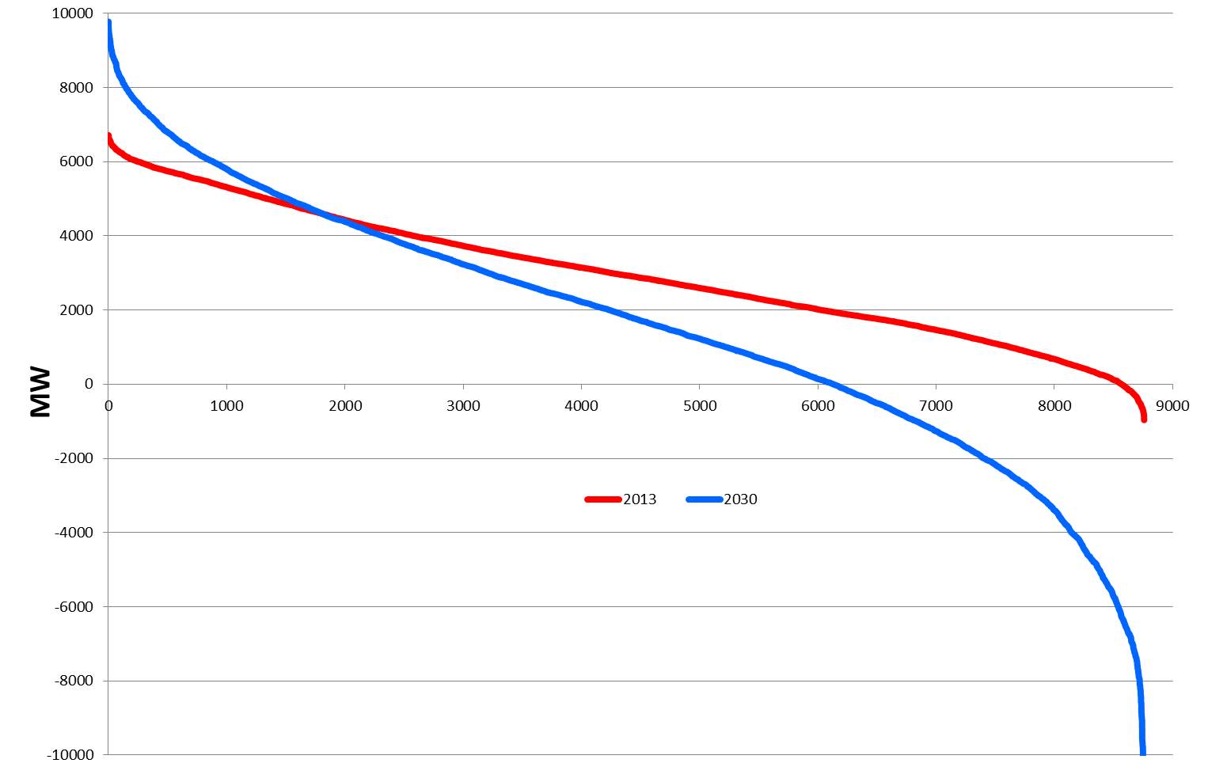
  Classified residual load
2013
Under coverage
2030
Surplus due to excess
generation

Slide 32
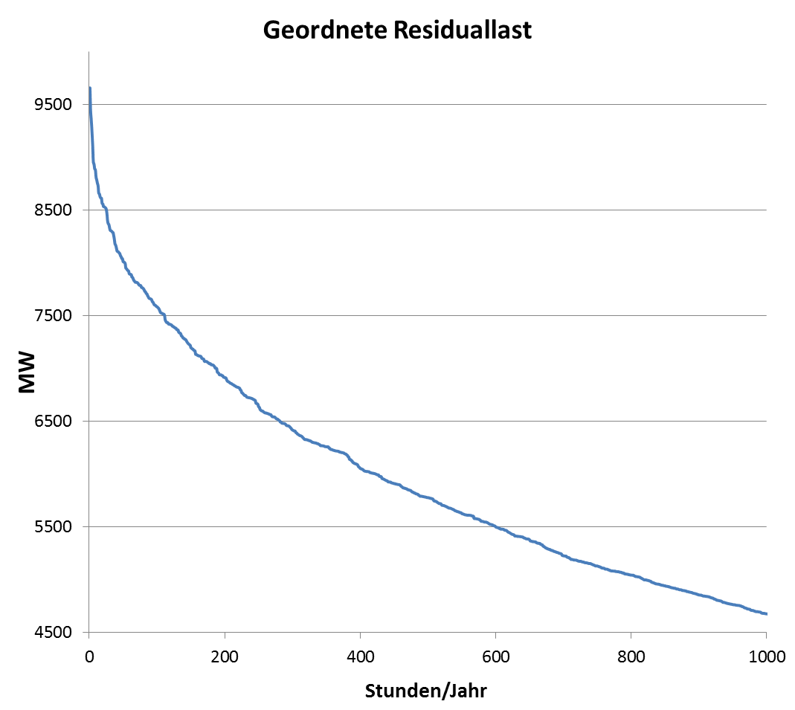
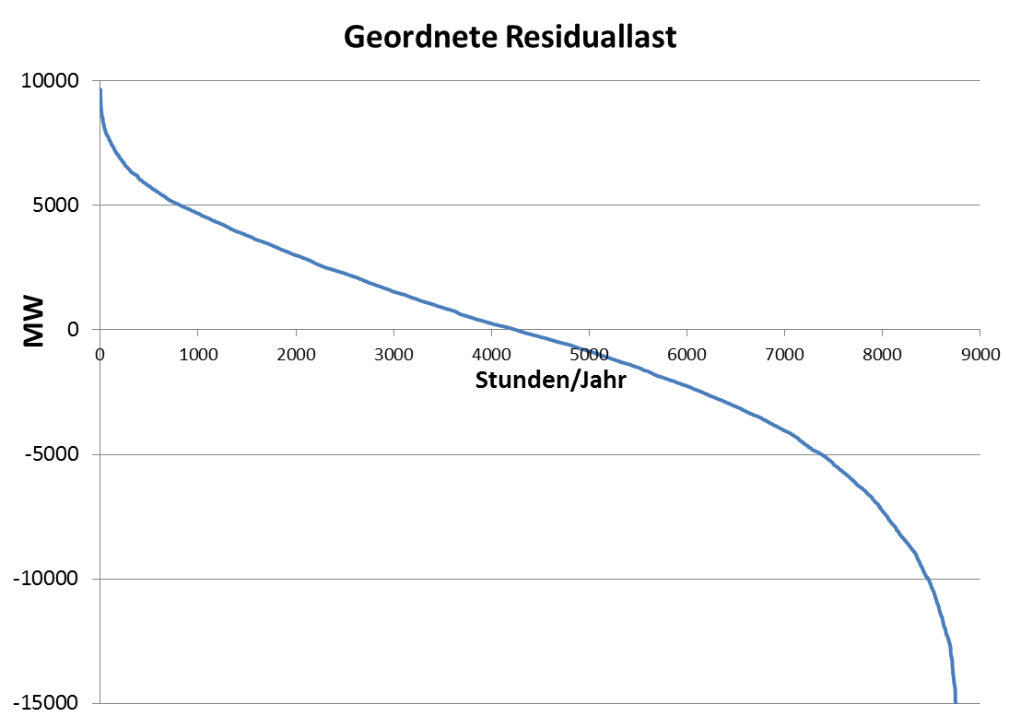
Classified residual load
Under coverage
How to cover?
Excess
production

Slide 33
By a regulated capacity „market“ ?
or
By competition between supply-side and demand-side technologies (incl. storages and grid)?

Slide 34
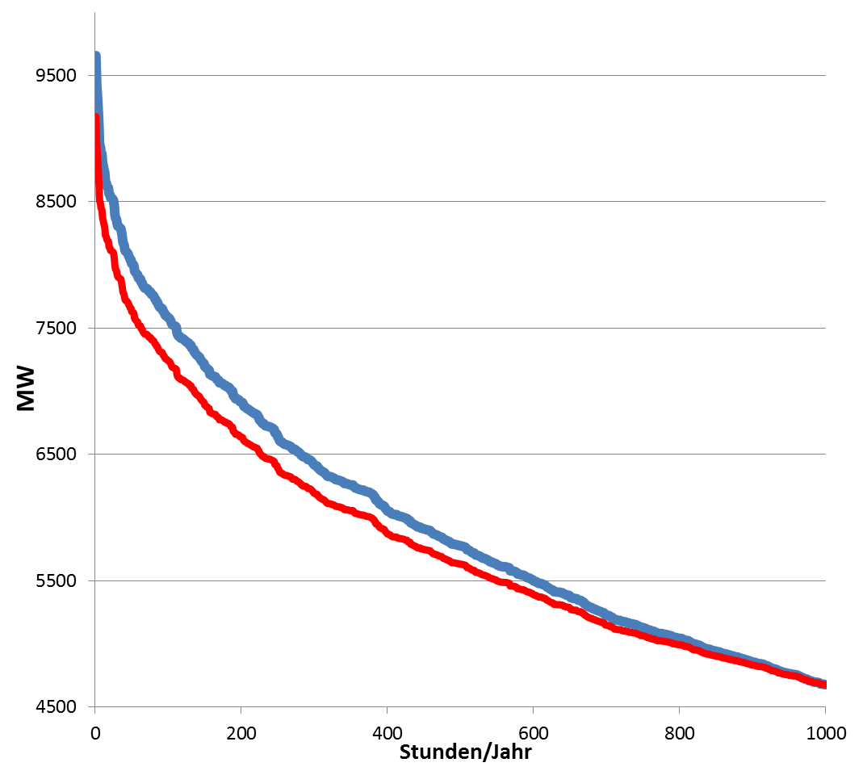
Flexible coverage of residual load
Extention
Transmission grid
Very high prices
(2000 EUR/MWh!
Load reduction due to
Demand response to prices
MW
Load reduction due to
Demand-side management
technical (e.g. cycling)
Smart Grids
Storages
Flexible power plants
Hours/year

Slide 35
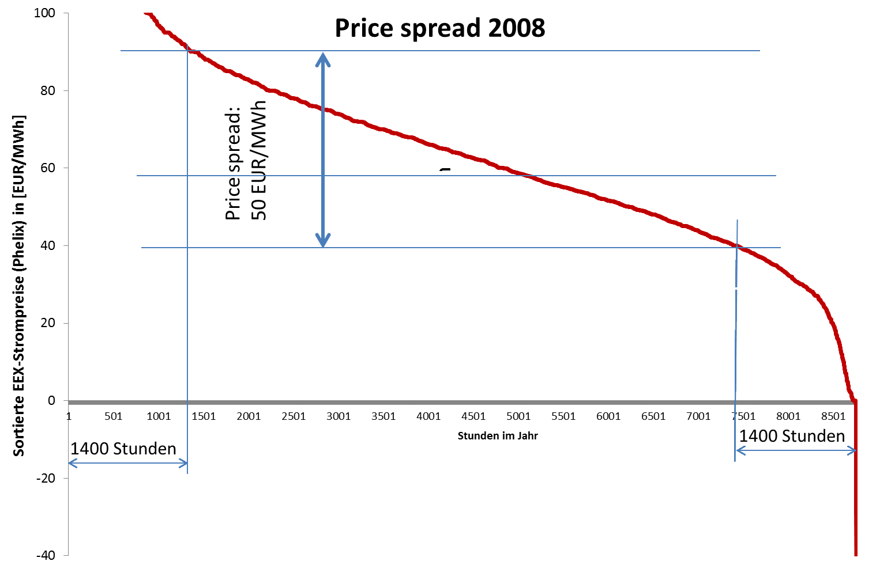
ECONOMIC INCENTIVES
Price spread:
50 EUR/MWh

Slide 36
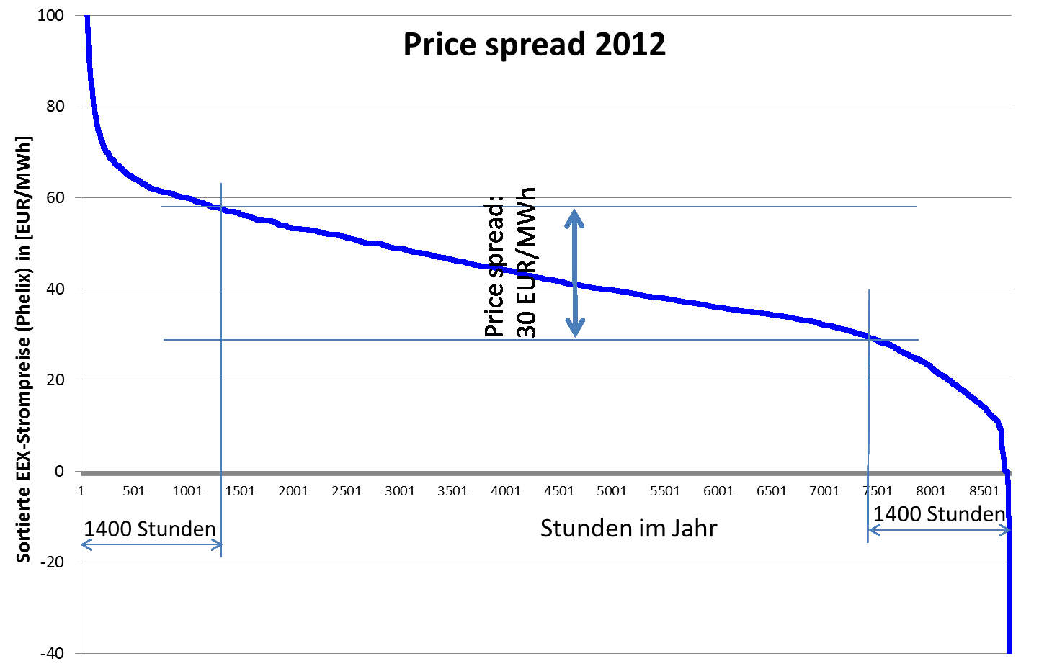
Price spread:
30 (!!!) EUR/MWh
→ There is no incentive today to launch flexibility
measures (except in the control power market)!

Slide 37
OLD THINKING
Genera-
tion
Grid
Supply
Demand
Flexibility options
Storage

Slide 38
New Thinking: Making the electricity
system more democratic
Grid
Balancing
Group/
Supplier
G1
Custo-mers
G3
Flexibility options
G2
G4
Storage
Storage

Slide 39
6. CONCLUSIONS
A sustainable electricity system is not a
technological winner-picking problem!
It is a question of integrating a broad portfolio of
technologies and demand response options!
most important now: exhaust the full potential of
the creativity of all market participants!
The key: Flexibility! Yet, currently no economic
incentives but activities started → very promising!
Very important: correct price signals!!!
calls for capacity markets: a last try of the old
generation-focused system to survive
New key player: Supplier, no more the generator!

Slide 40
APP. A: CAPACITY
MARKET MODELS
P=
STMC
P=
LTMC
DS
contracts
Exist.
cap.
New
cap.
EOM classic
X
EOM revised
X
EOM + DCM
X
X
Compreh. CCP
X
X
Focused CCP
X
X
X
EOM…Energy-only market
CCP…Centralized capacity payments
DCM…Demand-side capacity market

Slide 41
OPEN QUESTIONS
REGARDING CCP:
Which quantity of capacity where?
How to split in existing and new capacity?
How to tune with grid extention?
Who plans? On national or international level?
E.G. CCP in DE influence operation of Austrian and Swiss hydro storages
Capacity MARKETS??? How should competition take place in a specific region with one supplier?
Or in France???

Slide 42
THE PLANNING SPIRAL
CCP Inter-national
Financing inter-national?
CCP
National
Grid extention Nat./Int.
Storage Internat.
Central European planning commission!
Conclusion: Increasing planning!

Slide 43
Regional decentral
capacity „MARKETS“ ???
Capacity problems on regional level!
Statement EWI Cologne, in favour of CCP:
“If we introduce capacity markets they must ensure full supply security. That is to say the capacities we need must at least to some extent be higher than expected demand, including a security margin” (Energy&Management, March 2013)
Now imagine which excess capacity comes about if all European REGIONS do this on there level…
→ Huge additional costs!

Slide 44
APP. B: THE ROLE OF STORAGES

Slide 45
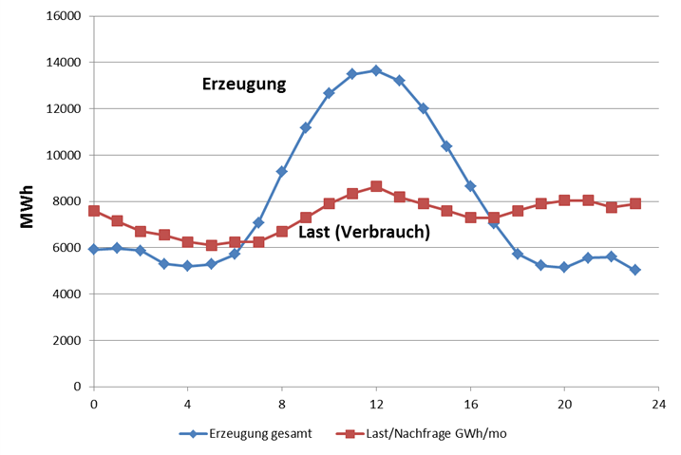
EXAMPLE: RESIDUAL LOAD
Generation
Residual load
Load
Hours over a day
Residual load = Load – non-flexible production

Slide 46
2. The costs of storage
C … Storage costs (EUR per kWh)
C_{E} … Energy costs (EUR per kWh)
C_{OM} … O&M costs (cent per kWh)
IC … Investment costs (EUR/kW)
… Capital Recovery factor
T … Fullloadhours (hours per year)
η_{SP} … Efficiency of storage
Key factors:
T (Fullloadhours)!
C_{E} (electricity price)

Slide 47
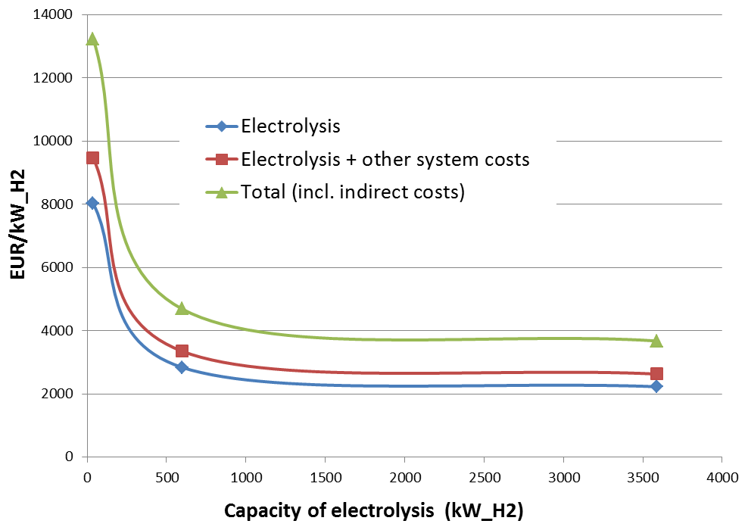
Investment costs of hydrogen production 2014
→ High economies-of-scale !

Slide 48
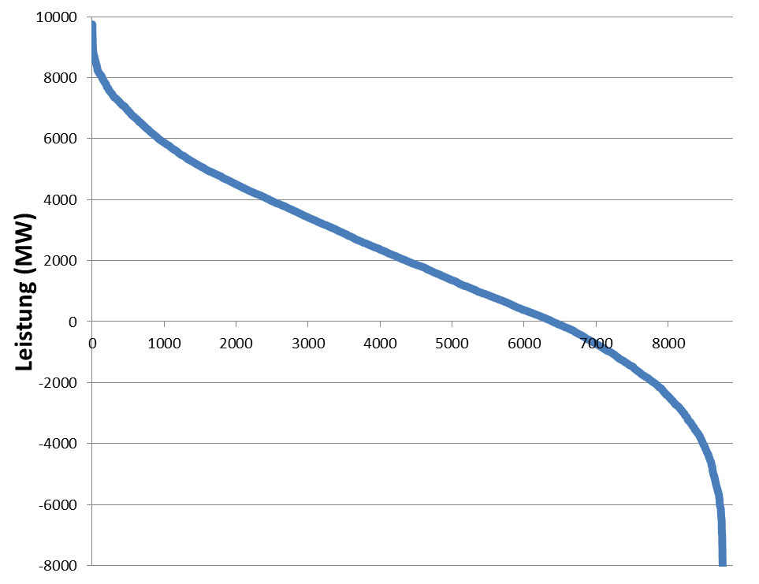
Decreasing full-load hours of
storages
FLH Storage 2
Storage 2
Storage 1
FLH Storage 1
Residual load
Under coverage
excess
generation

Slide 49
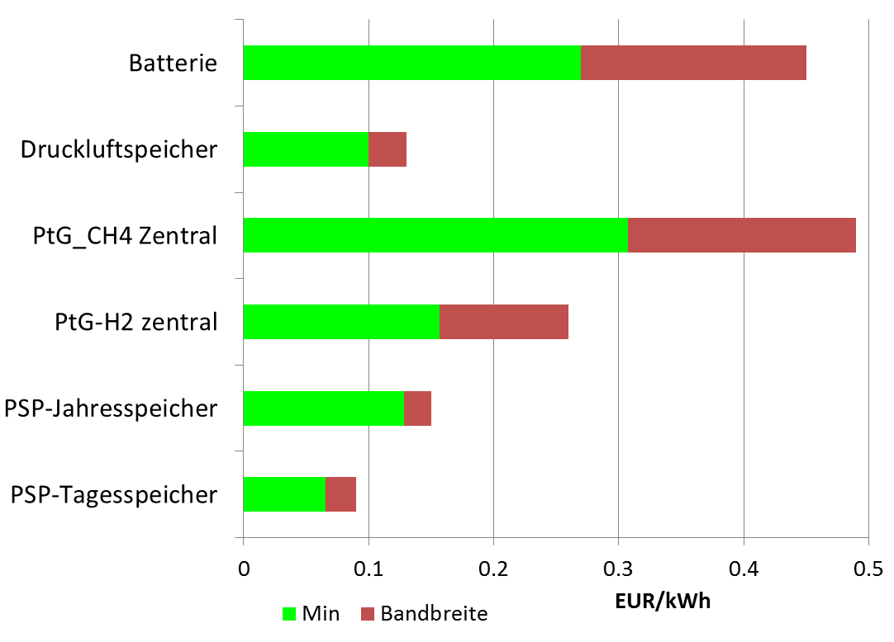
Range of costs 2015
Battery
CAES
PtG-CH4 central
PtG-H2 central
Pumped Hydro year
Pumped Hydro day
Household
electricity price
Range
Minimum
Price spread wholesale market 2014

Slide 50
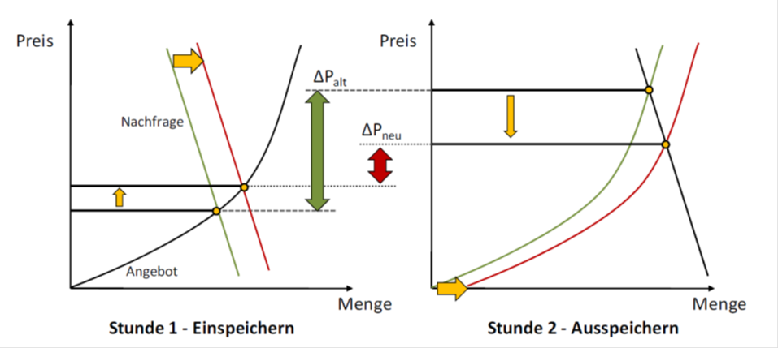
The impact of new storage
on price spreads
Neuer price spread!
Stunde 1: Einspeichern
Stunde 2: Ausspeichern
Quelle: Ehlers 2011

Slide 51
Sectror coupling / Sector integration

Slide 52
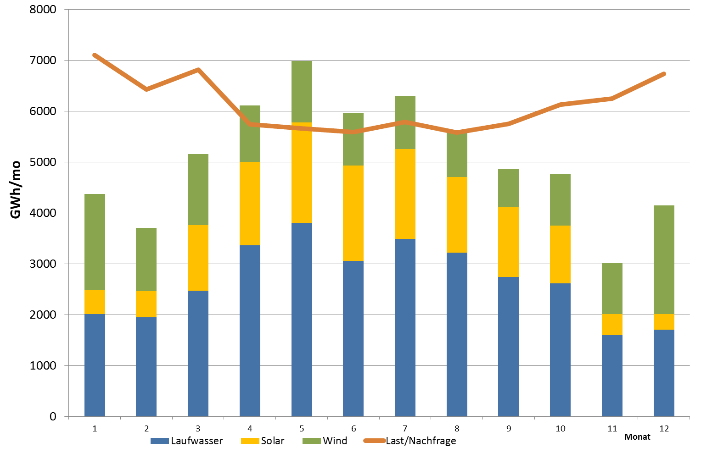
Demand for long-term storage
Long-term storage needed

Slide 53
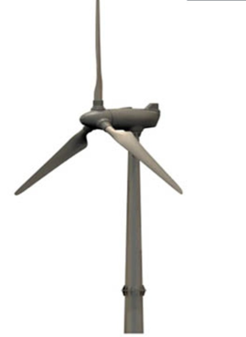

Hydrogen: storage and roundtrip use for electricity generation
Very low roundtrip efficiency for electricity!
η= 27-35%
η=27-38%
η ≈90%
η=50-60%
η=60-70%
Compressor
Combined cycle
Electricity
H₂
Electricity
Electrolyser
G
H₂
H₂
H₂-Storage

Slide 54
Using hydrogen and methane
in transport

Slide 55




Hydrogen: storage and fuel
η=27-38%
η ≈90%
η=50-60%
η=60-70%
Compressor
Combined cycle
Electricity
H₂
Electricity
Electrolyser
G
H₂
H₂
H₂-Storage
Energy supply chains: Storage and/or use of RES for mobility

Slide 56
Costs scenarios for long-term storage technologies

Slide 57
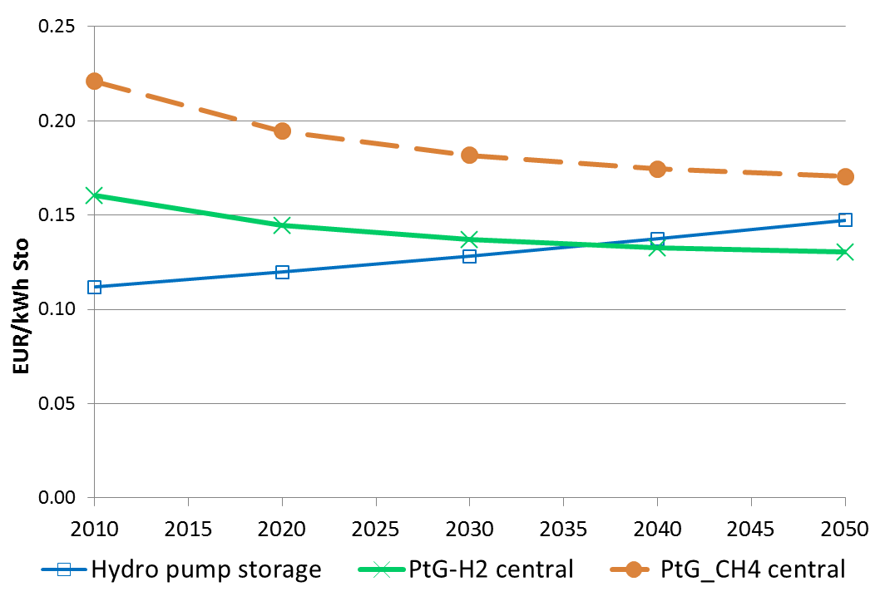
Storage costs optimistic 2010 - 2050
(Electricity costs = 0, T=1800 hours/year)
Methane
Hydrogen
Pumped Hydro year
Electricity price spread

Slide 58
ANNEX: SUPPLY SECURITY AND
DIMENSIONS
Historical (anachronistic) definition:
At every point-of-time every demand
has to be met regardless of the costs!
(Note:
Supply security is an energy economic term!
Supply security = system reliability!)

Slide 59
HISTORICAL SUPPLY
SECURITY
D_{t_SS}
Conditions:
S_{t_SS} > D_{t_SS}
P_{t} = Average costs
Costs,Price (EUR/MWh)
Supply curve S_{t_SS}
D_{t_SS}.....Maximal observed or forecasted demand
MW

Slide 60
Historical SS + Centralized Capacity Payments (CCP)
=
New market DESIGN!
(=planned economy)

Slide 61
A MARKET DESIGN
WTP
At times of lowest WTP costs of supply are highest!!!
Costs,Price (EUR/MWh)
MC
Price: WTP=MC
MW
MW_Market
MW_Current
PhD thesis Praktiknjo: A wide range of WTP on the demand-side!

